Slide 1
Machine Learning
Notes:
A look the field of machine learning. We have emphasized the importance of some form of feedback to the system.
With supervised learning the agent is provided with immediate feedback so that it knows at once if it has been correct.
With unsupervised learning no feedback is provided while training is ongoing; however, eventually the agent will know if it is performing well.

Slide 2
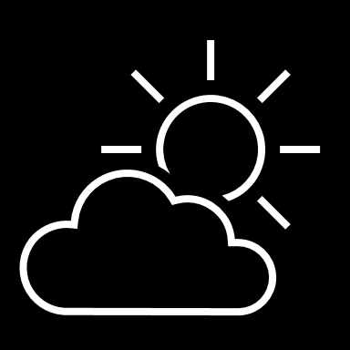
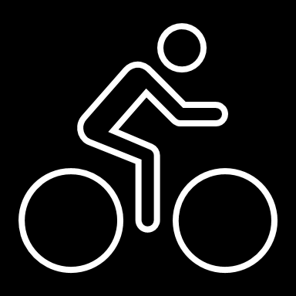
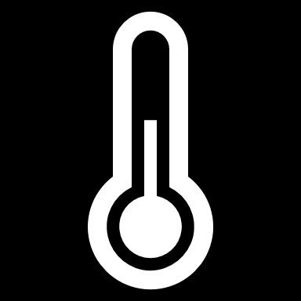
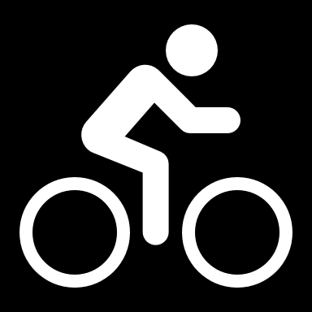
Regression
56 | 115
61 | 126
67 | 137
72 | 140
76 | 152
82 | 156
x y
Training
ŷ
116
128
137
146
155
1.5
f(x)
1
35
f(x)=35 + 1.5x
54 | 114
62 | 129
68 | 130
74 | 152
80 | 154
Validation
Notes:
This is an animated slide – use the notes below to talk to each animation build (clicks are indicated by numbers)
One of the most common machine learning technique is called regression. You use regression when you want to predict a numeric value; like a price, a sales total, or some other measure.
Let's look at an example and get an idea of how it works. There's a little mathematics involved, but don't worry – the basic idea is fairly straightforward!
In this example, we'll imagine a bicycle rental company that wants to predict the number of rentals on a given day based on weather conditions.
We'll start with some historical data about cycle rentals. For this simple example, we'll restrict this to just the temperature and number of rentals per day. In reality there would be more factors to consider. {A table of data showing daily temperatures and the number of rentals appears}
The number of rentals is the label we're going to predict, and we're going to use the daily temperature as a feature on which to base the prediction. Generally, we refer to the feature (or features) as X and the label as Y; and what we're going to do is to try to figure out a function that we can apply to X to get the value of Y. This function will be the basis for a model that we can use to predict Y for any given value of X. {X appears above the temperature column, and Y appears above the rentals column}
When we find a function, we'll want to validate it with some data for days where we already know the number of rentals so we can see how well it predicts; so we'll split the data into a subset that we'll use the train the model, and hold back a subset for validation. {The table is split into a training subset and a validation subset}
To find an appropriate function, let's plot the X and Y values so we can visualize the relationship between them. {A chart showing X values plotted against Y values from the training subset is displayed
Looking at the plot, you can see a trend in which higher temperatures tend to correlate with more rentals. In fact, we can fit a line between the plotted points that more or less describes this correlation and we can use this line to work out a calculation that produces Y from X. The ability to use a line like this to define a function for the X/Y relationship is technically called linear regression; which sounds complicated, but let's look at the basic principle of how it works and hopefully you'll find that it's actually fairly intuitive. {A diagonal line showing a trend where high X values tend to correlate to high Y values is added to the chart}
The point where the line intercepts the Y axis is around 35… {The point where the line intersects the Y axis is highlighted on the chart}
…and the slope of the line is such that for every 1 unit of X it goes along, it goes up around 1.5 units of Y… {The slope of the line is shown by an arrow going left for 1 unit and an arrow going up for 1.5 units}
…so the function that operates on X to find Y is 35 plus 1.5 times X. {The function "f(x) = 35 + 1.4x" is displayed}
Now we can test that function with the validation data that we held back. Here are the values we get from the function for the temperatures on those days – because this is a prediction of Y rather than the actual Y value, we write it with a little "hat" and call it Y-hat. {A column of values calculated by using the function is added alongside the actual Y values in the validation subset}
Let's plot the actual values from the validation data along with the line from which the predicted values were calculated. {The actual values from the validation subset are plotted on the chart alongside the line that represents the predictive function}
Now we can see how well the model predicts by measuring the difference between the predicted values and the actual values that we know to be true – this tells us the amount of error in the model. There are various ways to calculate this error value and generate common metrics that we can use to evaluate a regression model. {Arrows indicating the distance between each actual value and the prediction function line are added to the chart}
This is a simple example, just to describe the general concepts and process for training and evaluating a regression model. In a real-world scenario, the training algorithm would need to fit multiple features (X values) to a regression function; but the basic principles remain the same. You start with some data that contains features and labels, you use some of the data to train a regression model by using an algorithm that tries to determine a function for X that predicts Y; and then you evaluate the trained model using the validation data that you held back. If you're happy with the level of error in the model, you can then use it to infer unknown label values in new cases.

